Slide 1

7th Grade Accelerated Math
Unit 1, Lesson 9 Solving Inequalities – Part 1 Volume 1, pg. 51

Slide 2


Benchmark
MA.8.AR.2.2
Solve two-step linear inequalities in one variable and represent solutions algebraically and graphically.
volume 1, pg. 51

Slide 3
Integrated Mathematical Thinking and Reasoning Standards
MA.K12.MTR.1.1 Actively participate in effortful learning both individually and collectively.
MA.K12.MTR.2.1 Demonstrate understanding by representing problems in multiple ways.
MA.K12.MTR.4.1 Engage in discussions that reflect on the mathematical thinking of self and others.
MA.K12.MTR.5.1 Use patterns and structure to help understand and connect mathematical concepts.
MA.K12.MTR.6.1 Assess the reasonableness of solutions.
volume 1, pg. 51

Slide 4

Learning Target
I can solve inequalities and represent the solutions on a number line.
volume 1, pg. 51

Slide 5

Warm-Up
volume 1, pg. 52

Slide 6

1.9.1 Warm-Up: Bell Work
Solve and graph each inequality.
$35<5−3x$
$6.5−\frac{3}{4}n>12.5$
volume 1, pg. 52

Slide 7

Guided Instruction
volume 1, pg. 52

Slide 8
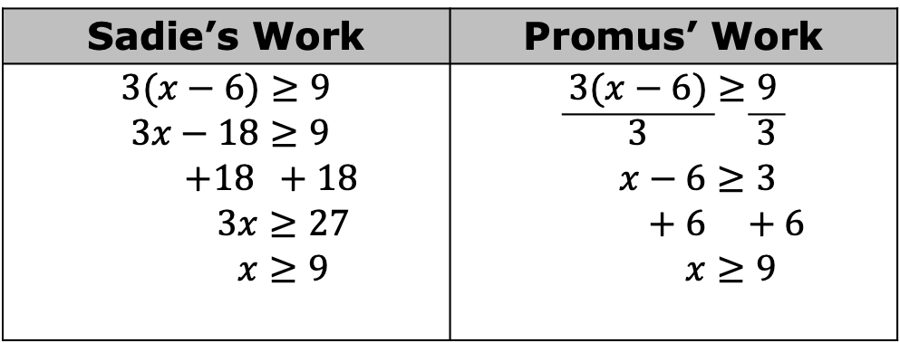

1.9.2 Guided Instruction: Solving Multi-Step Inequalities
Sadie and Promus each solve the inequality $3(x−6)≥9$.
1. Compare and contrast Sadie’s and Promus’ work.
Sadie’s Work | Promus’ Work
$$3(x−6)≥9$$ $$3x−18≥9$$ $$+18 +18$$ $$3x≥27$$ $$x≥9$$ | $$3(x−6)≥9$$ $$\overline{ 3 } \overline{ 3 }$$ $$x−6≥3$$ $$+ 6 +6$$ $$x≥9$$
volume 1, pg. 52

Slide 9
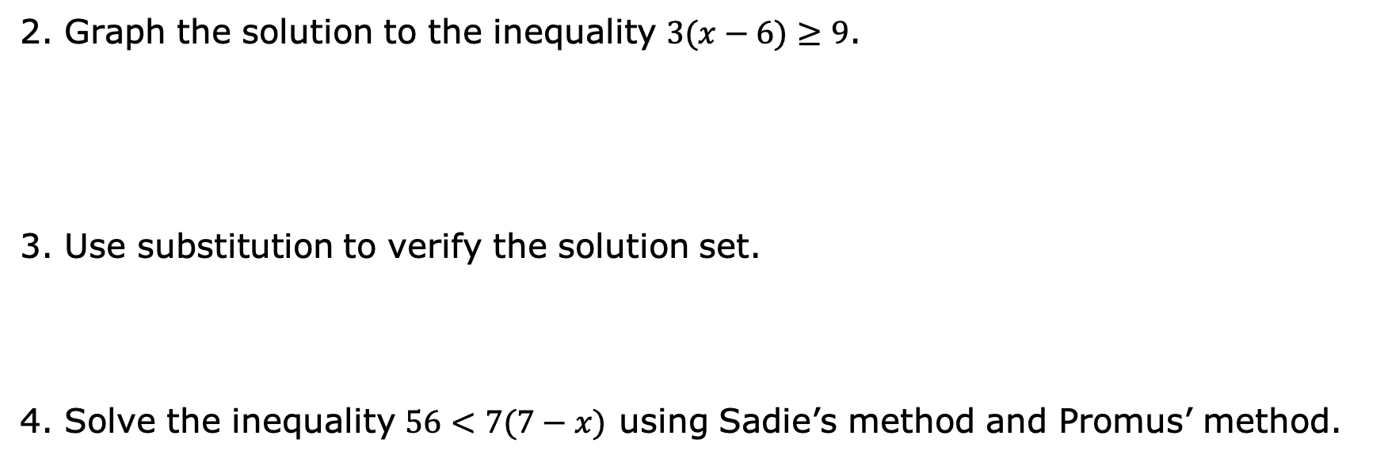
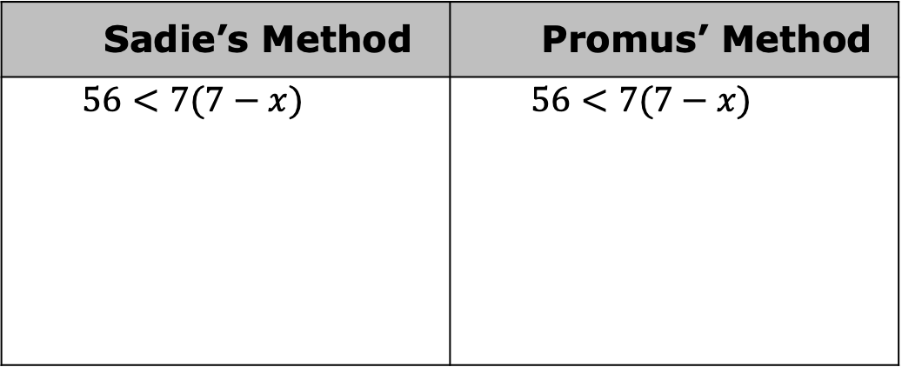
2. Graph the solution to the inequality $3(x−6)≥9$.
3. Use substitution to verify the solution set.
4. Solve the inequality $56<7(7−x)$ using Sadie’s method and Promus’ method.
Sadie’s Method | Promus’ Method
$$56<7(7−x)$$ | $$56<7(7−x)$$
volume 1, pg. 52

Slide 10

5. Graph the solution to the inequality $56<7(7−x)$.
6. Use substitution to verify the solution set.
7. Explain whether you prefer Sadie’s method or Promus’ method.
volume 1, pg. 53

Slide 11

Guided Practice
volume 1, pg. 53

Slide 12


1.9.3 Guided Practice: Solving Inequalities
Solve each inequality and graph the solution set.
a. $6\left(h+2\right)≥−12$
b. $−10>−\frac{2}{3}(p−3)$
c. $5.6\left(−4.5+x\right)<−36.4$
d. $\frac{3}{4}≥ \frac{1}{8}(\frac{4}{5}b−6)$
volume 1, pg. 53

Slide 13

Collaboration
volume 1, pg. 54

Slide 14
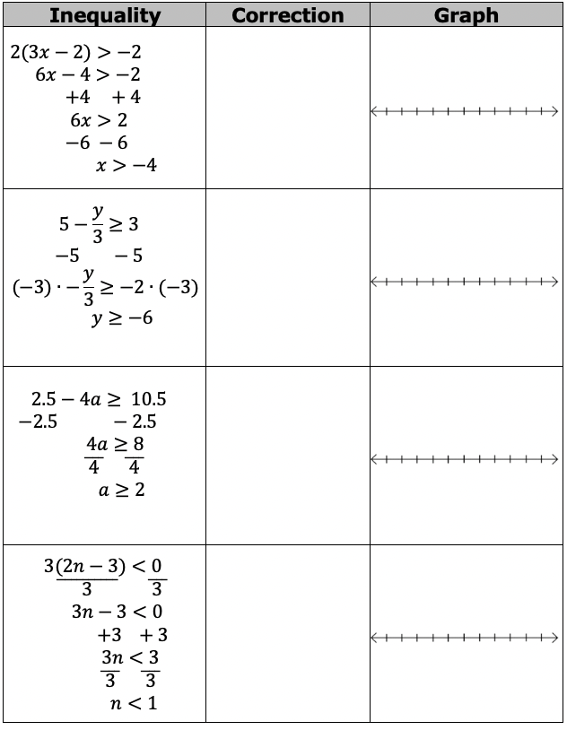

1.9.4 Collaboration: Error Analysis
1. Work with your partner to identify the errors in the table. Circle the mistake, solve the inequality correctly, then graph the solution set.
volume 1, pg. 54

Slide 15

Your Turn
volume 1, pg. 54

Slide 16

1.9.5 Your Turn!
1. Solve the inequality $5\left(x−1\right)>−40$ and graph the solution set on a number line.
2. Describe how to solve the inequality $32≥−4(y−10)$.
volume 1, pg. 54

Slide 17

Wrap-Up
volume 1, pg. 55

Slide 18
1.9.6 Wrap-Up: Reflection
Complete each statement to reflect on today’s learning.
When someone asks me what I did in math today, I can say …
b. The thing that made the most sense to me today was …
c. Something that I still do not understand is …
volume 1, pg. 55

